Slide 1




Slide 2
Presented by:
Jaspreet Kaur Chagger , Rahul Mathur , Mohd Azim & Prashant Chauhan
Problem Statement
Solution Adopted
Features of the Tool
Demo
Reusability

Slide 3


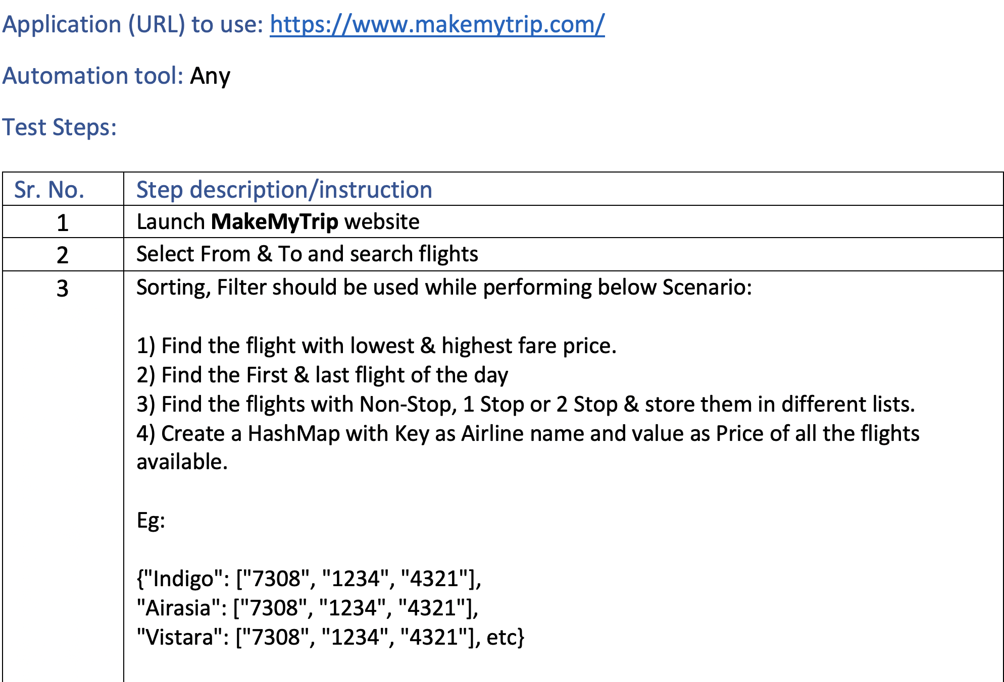


Problem Statement
@2020 Nagarro - All rights reserved

Slide 4
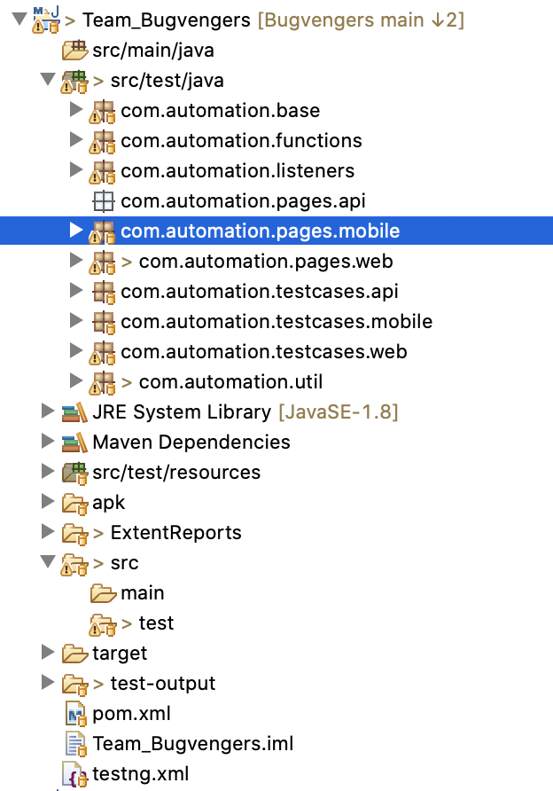
Solution Adopted
Common automation framework created for API, Web and Mobile Tests
Framework is based on Java, TestNg and Maven
Leverages Rest Assured for API, Selenium for Web and Appium library for Mobile Automation
@2020 Nagarro - All rights reserved

Slide 5
Features of Tool
Supports Parallel execution
Tests can be run via command line
Screenshot capture on Test success (Configurable) and Test Failures
Logging of Test Failures and Test success using ITestListner
Test reporting via Extent reports
Automatic download of Browser drivers based on browser selected for test
Based on Page Object Model
Page Factory Design pattern for Page classes
@2020 Nagarro - All rights reserved

Slide 6
Solution Adopted
Common automation framework created for API, Web and Mobile Tests
Framework is based on Java, TestNg and Maven
Leverages Rest Assured for API, Selenium for Web and Appium library for Mobile Automation
@2020 Nagarro - All rights reserved

Slide 7
Performance
Page for Rahul
@2020 Nagarro - All rights reserved

Slide 8
Performance
Page for Rahul
@2020 Nagarro - All rights reserved

Slide 9
Rest API
Page for Azim
@2020 Nagarro - All rights reserved

Slide 10
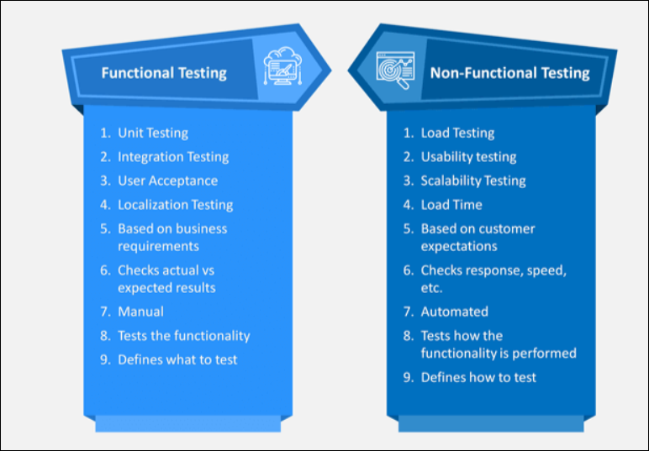
Functional & Non-Functional Test
@2020 Nagarro - All rights reserved

Slide 11
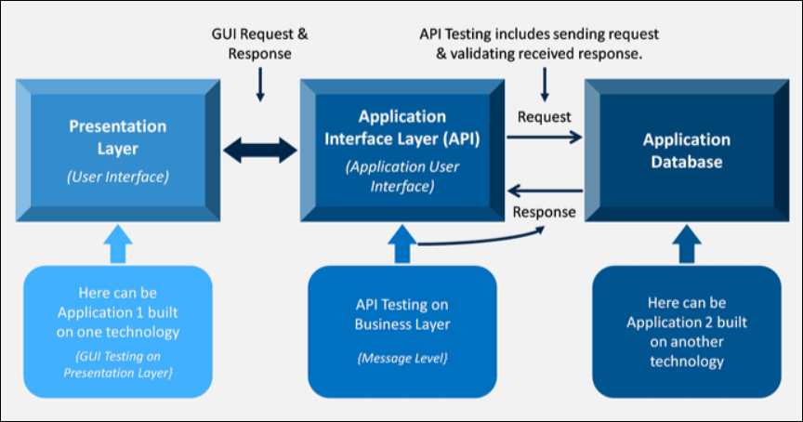
Approach for API Testing
@2020 Nagarro - All rights reserved

Slide 12
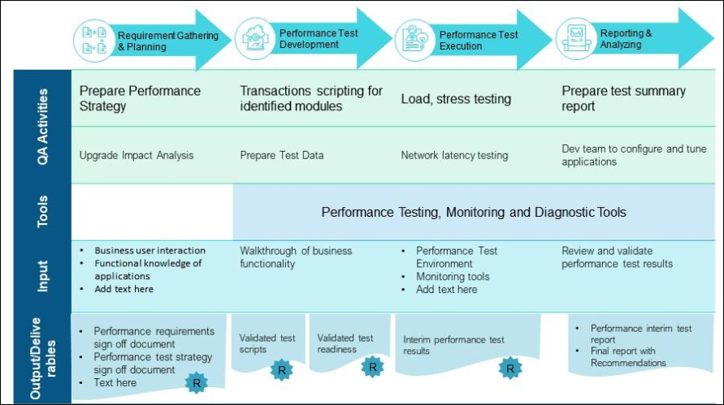
Approach for Performance test activities and deliverables
@2020 Nagarro - All rights reserved

Slide 13
Types Of Testing
Page for Prashant
@2020 Nagarro - All rights reserved

Slide 14
Thank You

